Slide 1

Quest: Shark Attacks
Members: David, Negar

Slide 2


Project Overview
Executive Summary:
Analyze the Shark Attack dataset, develop potential hypotheses, and clean and manipulate the data to uncover valuable insights aligned with the hypotheses.
Structure & Process Followed:
Imported the data and conducted an initial assessment
shape, info, null values %, key columns
Dropped rows with all null values and duplicates and not useful columns
Developed two hypotheses
Cleaned and manipulated the data according to these hypotheses
Wrapped up conclusions and Insights

Slide 3

Exploratory Data Analysis
Methodology Used in Hypotheses:
Created two hypotheses based on the initial data assessment.
Created specific datasets for each hypothesis.
Dropped irrelevant columns in each hypothesis.
Examples: [ 'Year', 'Type', 'Injury', 'Time', 'Species'].
Developed plots to visualize data and identified the primary drivers of each hypothesis.

Slide 4

Hypotheses
Hypothesis 1:
Shark attacks tend to happen in particular locations and during specific times of the year (seasons).
Hypothesis 2:
Certain activities and human factors, such as gender, may influence the occurrence of shark attacks.

Slide 5
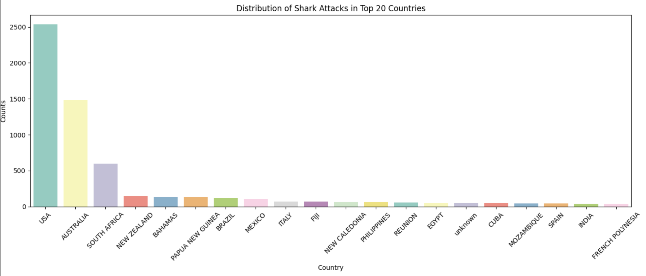
Hypothesis 1
Shark attacks tend to happen in particular locations and during specific times of the year (seasons).
Process Followed:
Created a dataset to assess location ([‘Country’, ‘State’]) and time [‘Month’]
Created a plot to visualize the top 20 countries with the most attacks and identified three main players: USA, Australia, and South Africa.

Slide 6
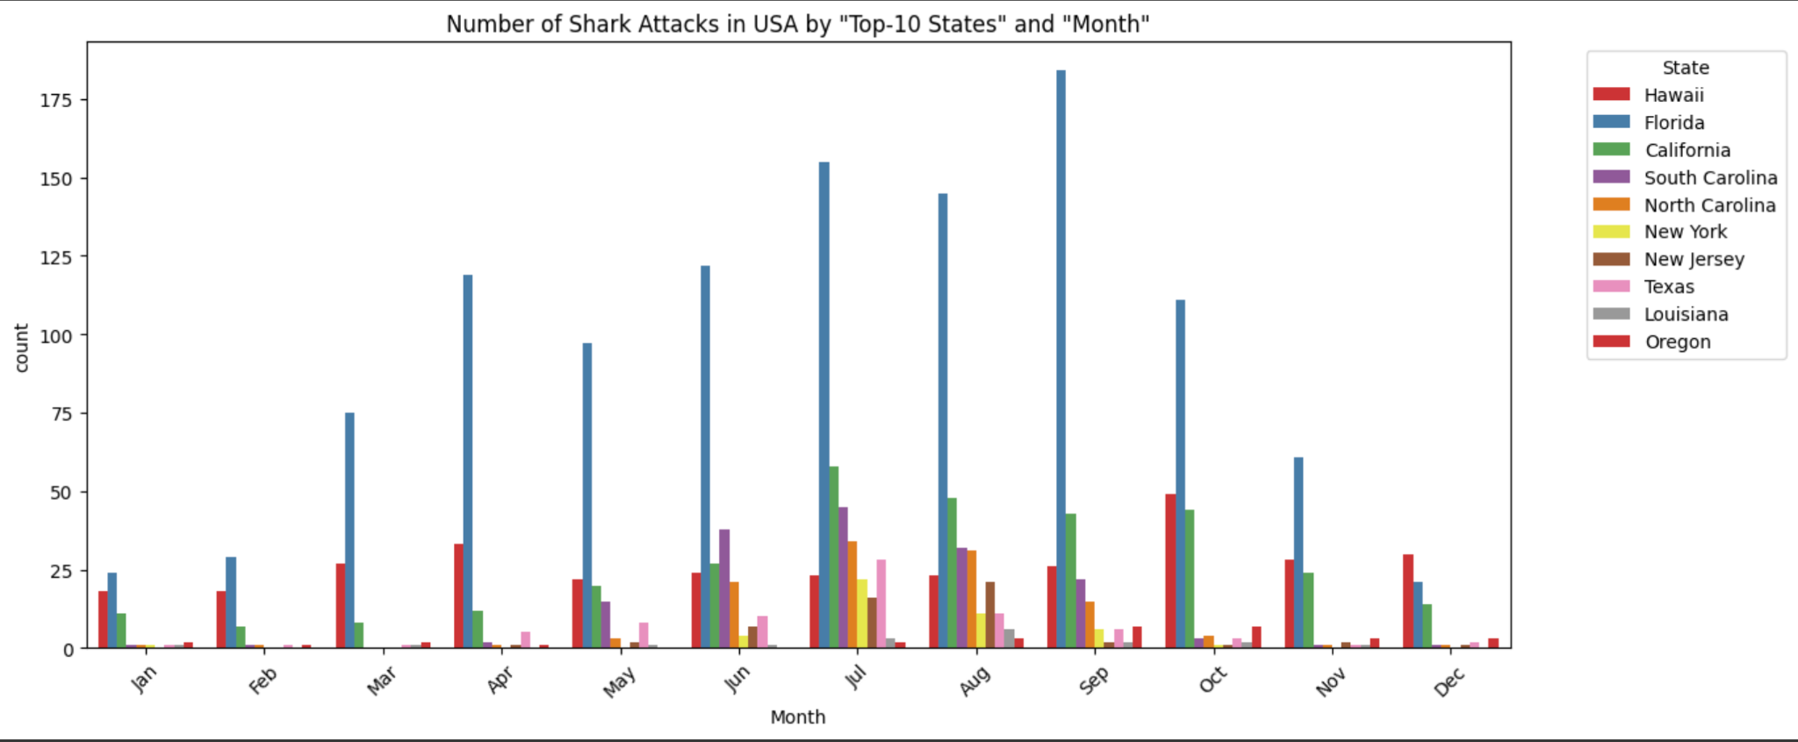
Results Hypothesis 1
Took the top 3 countries, created a new column [‘Month’], and examined by [‘State’]
The time of year (months & seasons) when most shark attacks occur:
USA > Summer (July, Aug, Sept)
🇺🇸

Slide 7
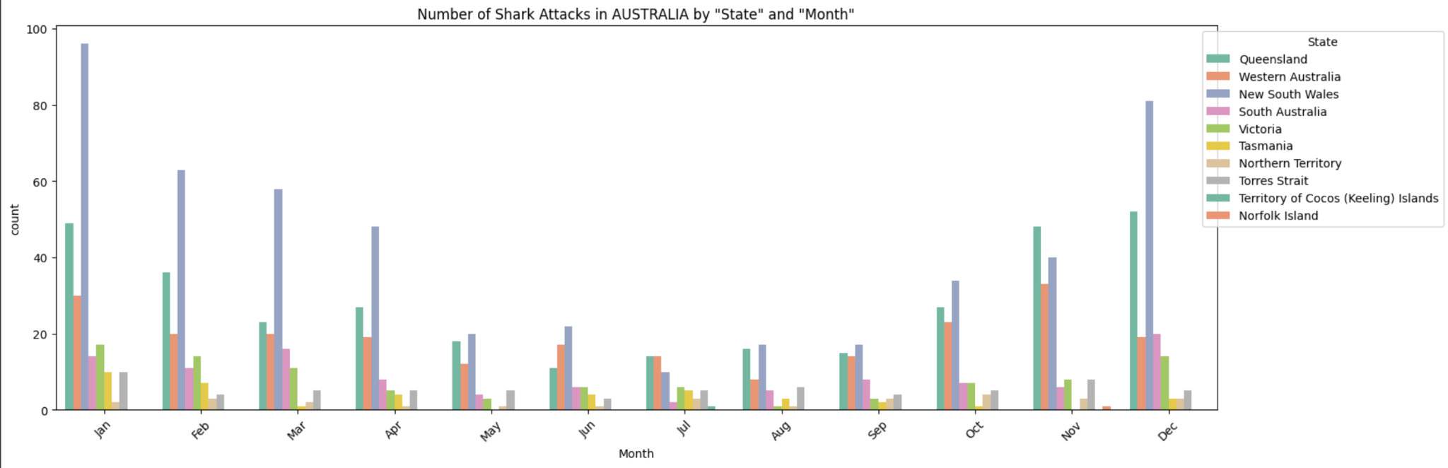
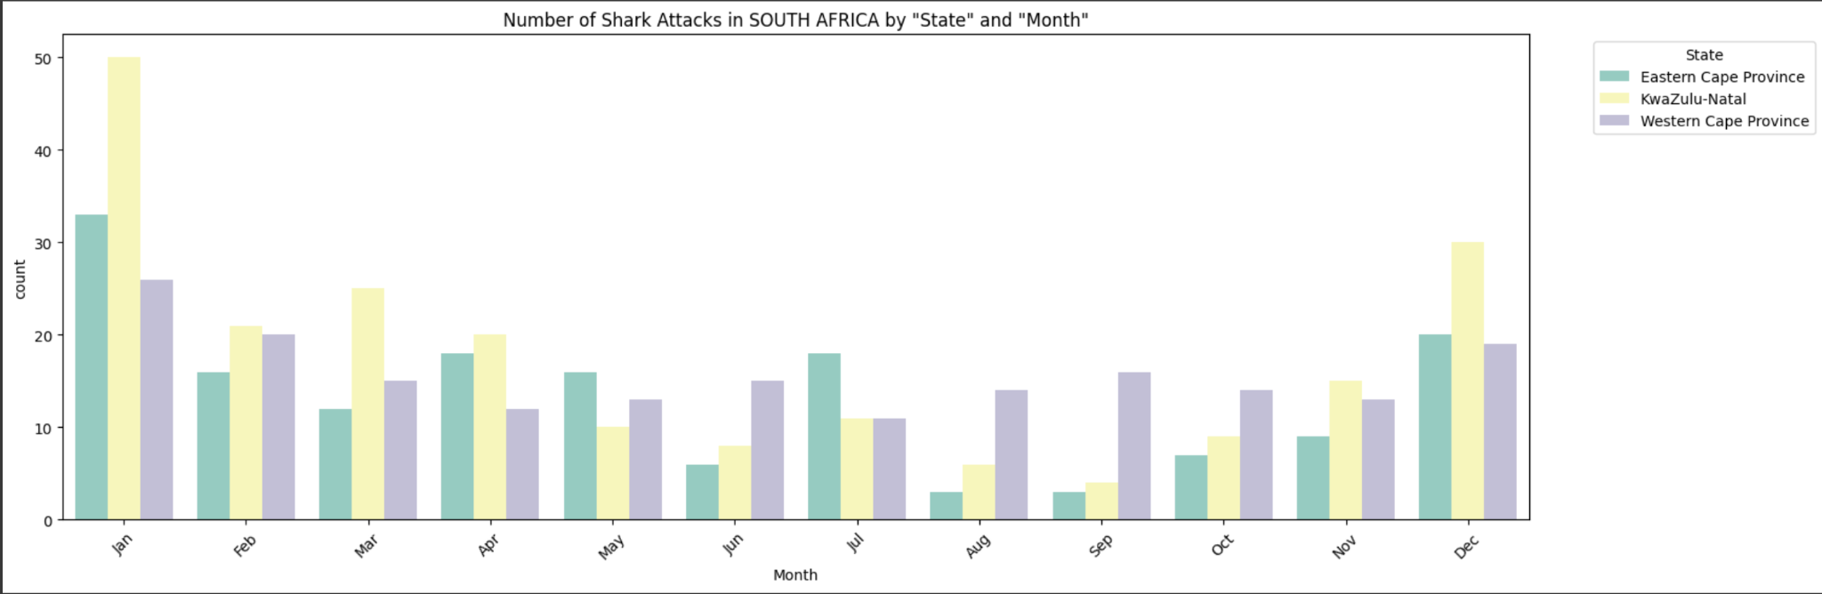
Findings Hypothesis 1
Australia & South Africa > Summer (Dec, Jan Feb)
🇦🇺
🇿🇦

Slide 8

Hypothesis 2
Certain activities and human factors, such as gender, may influence the occurrence of shark attacks.
Process Followed:
Created a specific dataset with relevant columns: [‘Activity’] and [‘Gender’].
Checked the percentage of null values in the relevant columns, ensuring they were below 10%.
Created a plot (x = Activity, y = Count of Attacks) to visually identify the top activities associated with shark attacks, segmented by gender.

Slide 9
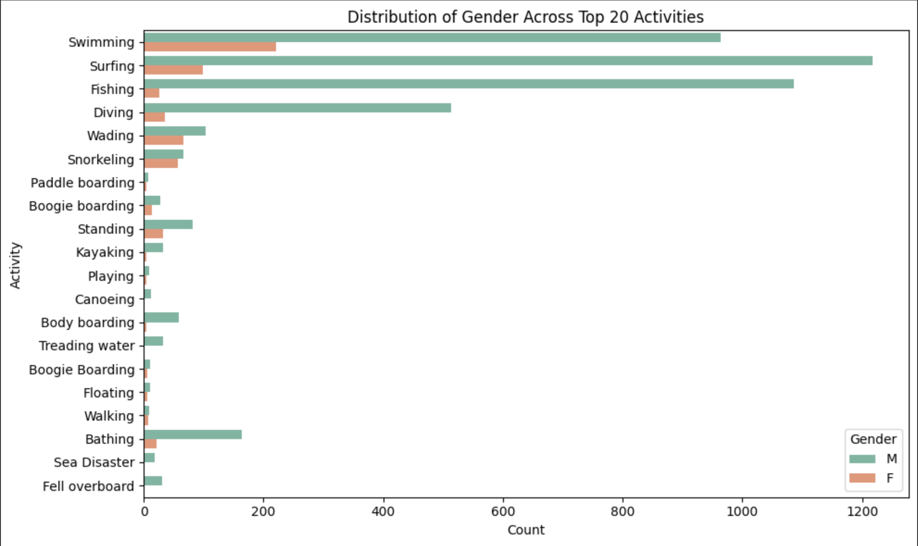
Findings Hypothesis 2
The top four activities where most shark attacks occur are: Swimming, Surfing, Fishing, and Diving.
🏊
🏄‍♂️
🎣
🤿

Slide 10

Conclusion and Insights
Hypothesis 1:
Learning: We confirmed that location (Country & State) and season are relevant when assessing the risk of shark attacks.
Key Finding: Summer is the primary season for shark attacks across hemispheres.
Potential Future Considerations: Investigate whether summer conditions such as water temperature or increased human presence contribute to this trend.
Hypothesis 2:
Examining top activities linked to increased shark attack risks was useful, but human factors such as gender showed minimal insights or correlations with activities.
Potential Implications:
☀️
Insights on location, season, and activity types could help shark attack prevention, planning and response strategies, such as warning campaigns, beach patrols, and medical support in high-risk areas (US, AUS, SA)

Slide 11


Data Wrangling and Cleaning
Challenges
Dealing with messy and incomplete data.
Handling columns with a high percentage of null values.
Addressing challenging mappings, such as [shark species], [activities].
Formatting the date column and extract them to another column called Month.
Consolidating similar but differently expressed values.such as (TURKS AND CAICOS":"TURKS & CAICOS")
Solutions
Dedicate time to an initial assessment to identify key [Columns] (with low number of unique and null values).
Creating data subsets.
Dropping irrelevant columns when assessing hypothesis.
Removing spaces and signs such as (?, !, &,...)
Replacing names of the incorrect values

Slide 12

Thank you

